Slide 1


DBScan
Density Clustering

Slide 2
When do K-Means fail?

Slide 3
Example 1 - Data

Slide 4
Step 2 - Calculate centroïds

Slide 5
Step 3 - Assign data points to the closest centroid

Slide 6
Step 2 - Calculate centroids

Slide 7
Step 3 - Assign data points to the closest centroid

Slide 8
Step 2 - Calculate centroids

Slide 9
Step 3 - Assign data points to the closest centroid

Slide 10
Step 4 - Get our K clusters

Slide 11
Example 2 - Data

Slide 12
Example 2 - K=2

Slide 13
Example 2 - Assign Data Points

Slide 14
Example 2 - Assign Data Points

Slide 15
Example 2 - Calculate Centroids

Slide 16
Example 2 - Calculate Centroids

Slide 17
Example 2 - Assign Data Points

Slide 18
Example 2 - Assign Data Points

Slide 19
Example 2 - Calculate Centroids

Slide 20
Example 2 - Calculate Centroids

Slide 21
Example 2 - Assign Data Points

Slide 22
Example 2 - Assign Data Points

Slide 23
Example 2 - Calculate Centroids

Slide 24
Example 2 - Calculate Centroids

Slide 25
Example 2 - Assign data points

Slide 26
Example 2 - Assign data points

Slide 27
Example 2 - Calculate Centroids

Slide 28
Example 2 - Calculate Centroids

Slide 29
Example 2 - Assign Data Points

Slide 30
Example 2 - Assign Data Points

Slide 31
Example 2 - Calculate Centroids

Slide 32
Example 2 - Calculate Centroids

Slide 33
Example 2 - Assign data points

Slide 34
Example 2 - Assign data points

Slide 35
Example 2 - Calculate Centroids

Slide 36
Example 2 - Calculate Centroids

Slide 37
Example 2 - Calculate Centroids

Slide 38
Example 3 - K=2

Slide 39
Example 3 - Assign data points

Slide 40
Example 3 - Calculate centroids

Slide 41
Example 3 - Assign data points

Slide 42
Example 3 - Assign data points

Slide 43
Example 3 - Fast forward

Slide 44
DBScan

Slide 45
New approach
Density => DBScan will create clusters based on how close each samples are from each other

Slide 46
Process
Define min_samples & eps
Take observations
Define if core sample
Get your clusters
1
2
3
4

Slide 47
Core metrics
Minimum Sample => How many observations to create a core sample
Epsilon => Maximum distance to define an observation as part of a sample

Slide 48
Example - Define min_sample & eps
min_sample = 4
eps = 0.2
1
0
1

Slide 49
Example - Take observation & define core samples
min_sample = 4
eps = 0.2
1
0
1

Slide 50
Example - Take observation & define core samples
min_sample = 4
eps = 0.2
1
0
1

Slide 51
Example - Take observation & define core samples
min_sample = 4
eps = 0.2
1
0
1

Slide 52
Example - Take observation & define core samples
min_sample = 4
eps = 0.2
Core Sample
1
0
1

Slide 53
Example - Take observation & define core samples
min_sample = 4
eps = 0.2
1
0
1

Slide 54
Example - Take observation & define core samples
min_sample = 4
eps = 0.2
1
0
1

Slide 55
Example - Take observation & define core samples
min_sample = 4
eps = 0.2
Another Core Sample
1
0
1

Slide 56
Example - Take observation & define core samples
min_sample = 4
eps = 0.2
1
0
1

Slide 57
Example - Fast Forward
min_sample = 4
eps = 0.2
1
0
1

Slide 58
Example - Non-core samples
min_sample = 4
eps = 0.2
?
?
1
0
1

Slide 59
Example - Non-core samples
min_sample = 4
eps = 0.2
1
0
1

Slide 60
Example - Non-core samples
min_sample = 4
eps = 0.2
Non-core samples
1
0
1

Slide 61
Example - Non-core samples
min_sample = 4
eps = 0.2
But within eps from other samples
1
0
1

Slide 62
Example - Define outliers
min_sample = 4
eps = 0.2
1
0
1

Slide 63
Example - Define outliers
min_sample = 4
eps = 0.2
No min_samples around
Further than eps away
1
0
1

Slide 64
Example - Define outliers
min_sample = 4
eps = 0.2
Outlier
1
0
1

Slide 65
Example - Same process with second cluster
min_sample = 4
eps = 0.2
1
0
1

Slide 66
Example - Same process with second cluster
min_sample = 4
eps = 0.2
1
0
1

Slide 67
Example - Same process with second cluster
min_sample = 4
eps = 0.2
1
0
1

Slide 68
Example - Same process with second cluster
min_sample = 4
eps = 0.2
1
0
1

Slide 69
How to choose min_sample & eps?

Slide 70
How to set min_sample & eps?
Low eps & High min_sample -> High density clusters
High eps & Low min_sample -> Low density clusters
Low eps & Low min_sample -> High outliers sensitivity
High eps & High min_sample -> Low outliers sensitivity

Slide 71
Choose types of distance for eps

Slide 72
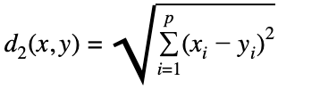
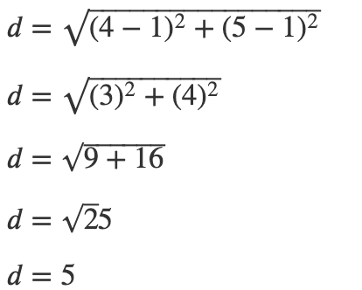
Euclidean Distance
B=(4,5)
A=(1,1)

Slide 73
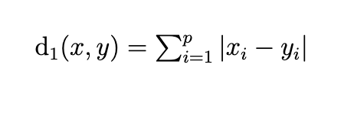
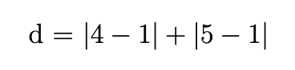
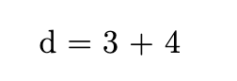
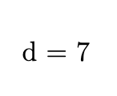
Manhattan Distance
B=(4,5)
A=(1,1)

Slide 74

Thanks!
See you in the next course

